Slide 1
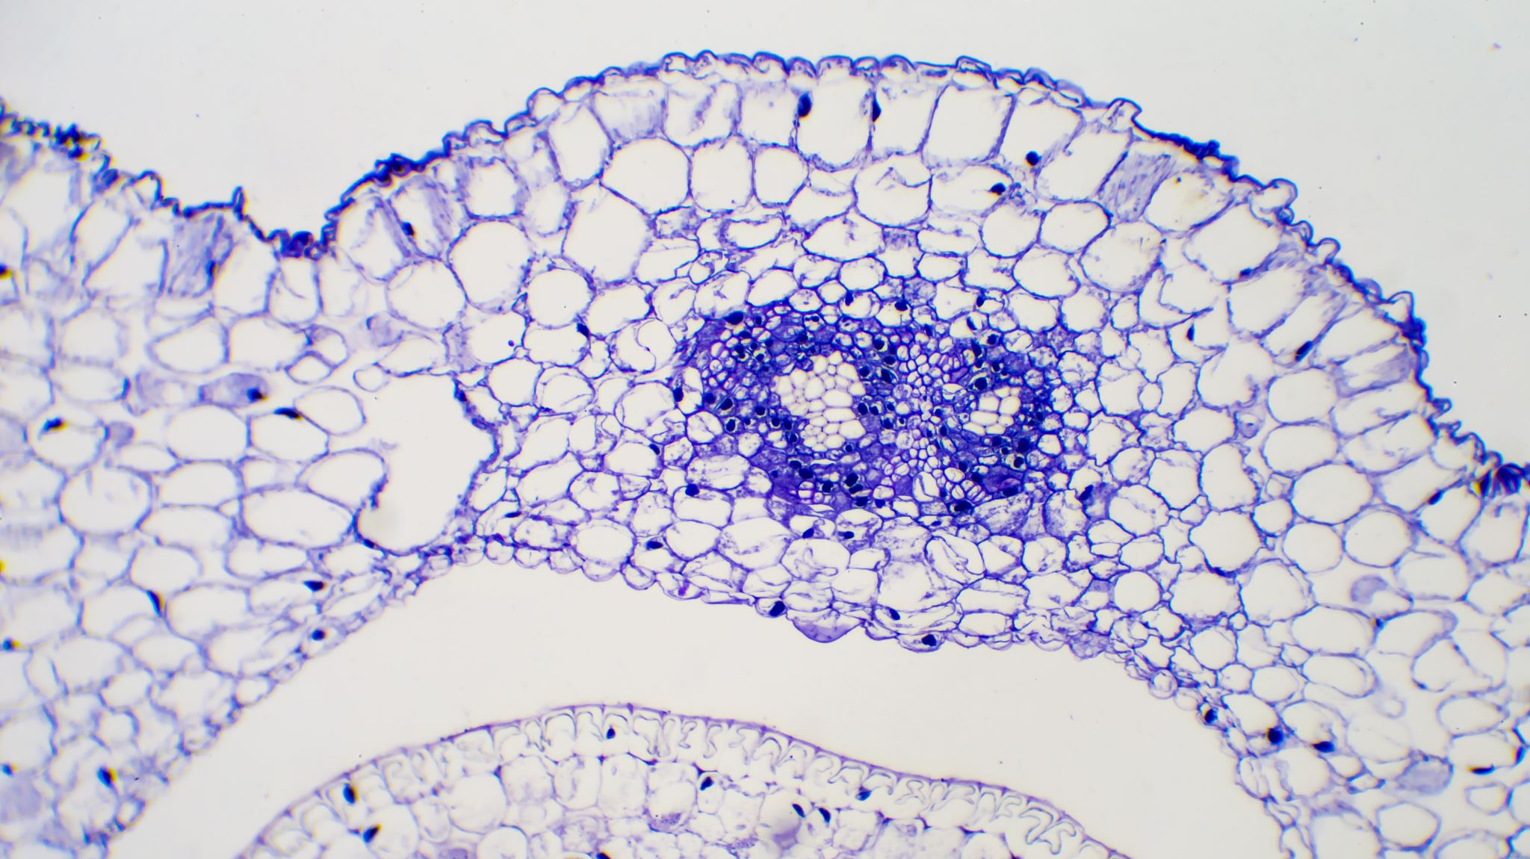
Long and Colon Cancer Classification
Using Tensorflow, Keras
- Apply Transfare Learning and OOP

Slide 2
Introduction
Project Overview
Objective: Develop a machine learning model for accurate lung and colon cancer classification.
Data: Utilized a comprehensive Kaggle dataset for model training.
Methodology: Employed advanced deep learning techniques.
Outcome: Achieved high accuracy in cancer detection.

Slide 3
Introduction
Project Overview
Objective: Develop a machine learning model for accurate lung and colon cancer classification.
Data: Utilized a comprehensive Kaggle dataset for model training.
Methodology: Employed advanced deep learning techniques.
Outcome: Achieved high accuracy in cancer detection.

Slide 4
Dataset Overview:
Source: Kaggle's Lung and Colon Cancer Histopathological Images dataset.
Content: Thousands of high-resolution histopathological images of lung and colon cancer.
Structure: Organized into directories based on cancer type.
Size: Substantial dataset with numerous images per category.

Slide 5
Dataset Overview:
Source: Kaggle's Lung and Colon Cancer Histopathological Images dataset.
Content: Thousands of high-resolution histopathological images of lung and colon cancer.
Structure: Organized into directories based on cancer type.
Size: Substantial dataset with numerous images per category.

Slide 6
Why this dataset?
High Quality: Carefully curated and labeled images for reliable training.
Diversity: Covers various cancer stages and types for comprehensive model learning.
Accessibility: Publicly available on Kaggle for reproducibility and further research.

Slide 7
Why this dataset?
High Quality: Carefully curated and labeled images for reliable training.
Diversity: Covers various cancer stages and types for comprehensive model learning.
Accessibility: Publicly available on Kaggle for reproducibility and further research.

Slide 8
Problem Statement:
Project Aim
Develop a robust machine learning model to accurately classify histopathological images of lung and colon cancer.

Slide 9
Problem Statement:
Project Aim
Develop a robust machine learning model to accurately classify histopathological images of lung and colon cancer.

Slide 10
Problem Statement:
Importance of Accurate Classification
Early Detection: Enables timely intervention for improved patient outcomes.
Diagnostic Precision: Supports pathologists by automating time-consuming tasks and reducing human error.
Resource Optimization: Improves efficiency in healthcare settings and reduces diagnostic costs.

Slide 11
Previous Work:
Convolutional Neural Networks (CNNs):
Widely used for medical image analysis and cancer classification.
Transfer Learning:
Utilizes pre-trained models (e.g., VGG, ResNet) to enhance performance.
Ensemble Methods:
Combines multiple models to improve accuracy and robustness.
Data Augmentation and Preprocessing:
Employs techniques like rotation, flipping, and normalization to increase data diversity and handle variations.
Evaluation Metrics and Benchmarks:
Standard metrics (accuracy, precision, recall, F1-score) and public benchmarks (e.g., Kaggle competitions) guide model assessment and comparison.

Slide 12
Previous Work:
Convolutional Neural Networks (CNNs):
Widely used for medical image analysis and cancer classification.
Transfer Learning:
Utilizes pre-trained models (e.g., VGG, ResNet) to enhance performance.
Ensemble Methods:
Combines multiple models to improve accuracy and robustness.
Data Augmentation and Preprocessing:
Employs techniques like rotation, flipping, and normalization to increase data diversity and handle variations.
Evaluation Metrics and Benchmarks:
Standard metrics (accuracy, precision, recall, F1-score) and public benchmarks (e.g., Kaggle competitions) guide model assessment and comparison.

Slide 13
Data Description:
Original Dataset:
750 lung tissue images (250 benign, 250 adenocarcinoma, 250 squamous cell carcinoma)
500 colon tissue images (250 benign, 250 adenocarcinoma)
Data Augmentation:
Utilized Augmentor package to expand dataset to 25,000 images.
Balanced dataset with 5,000 images per class.

Slide 14
Data Description:
Original Dataset:
750 lung tissue images (250 benign, 250 adenocarcinoma, 250 squamous cell carcinoma)
500 colon tissue images (250 benign, 250 adenocarcinoma)
Data Augmentation:
Utilized Augmentor package to expand dataset to 25,000 images.
Balanced dataset with 5,000 images per class.

Slide 15
Data Description:
There are five classes in the dataset, each with 5,000 images, being:

Slide 16
Data Description:
There are five classes in the dataset, each with 5,000 images, being:

Slide 17
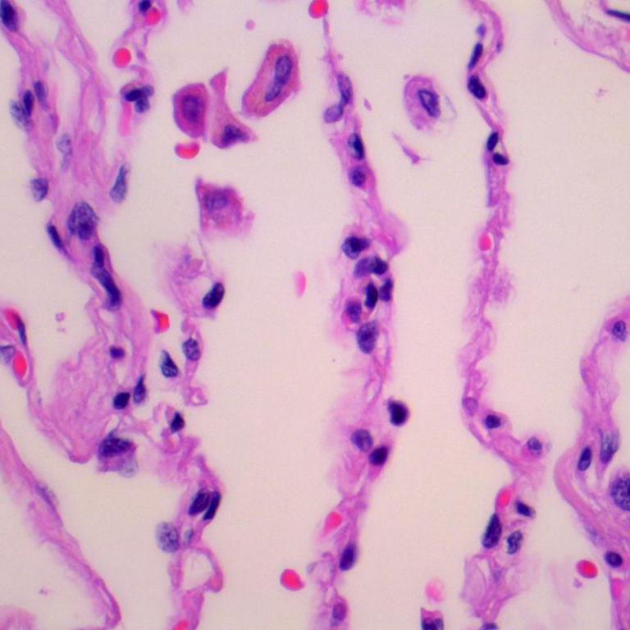
Lung benign tissue

Slide 18
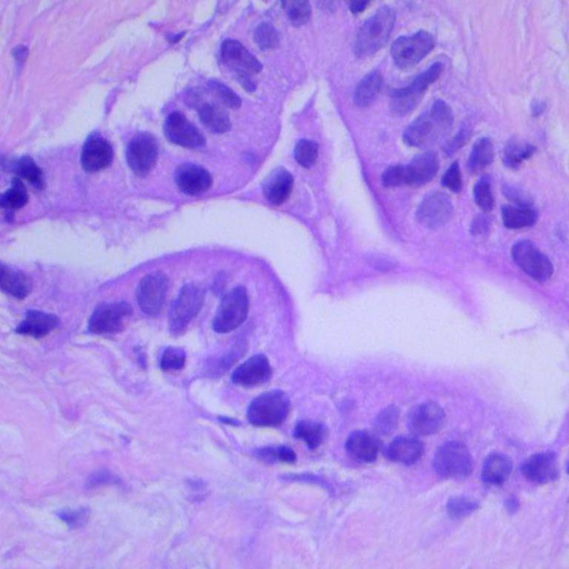
Lung adenocarcinoma

Slide 19
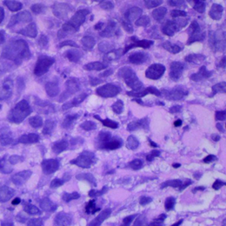
•Lung squamous cell carcinoma

Slide 20
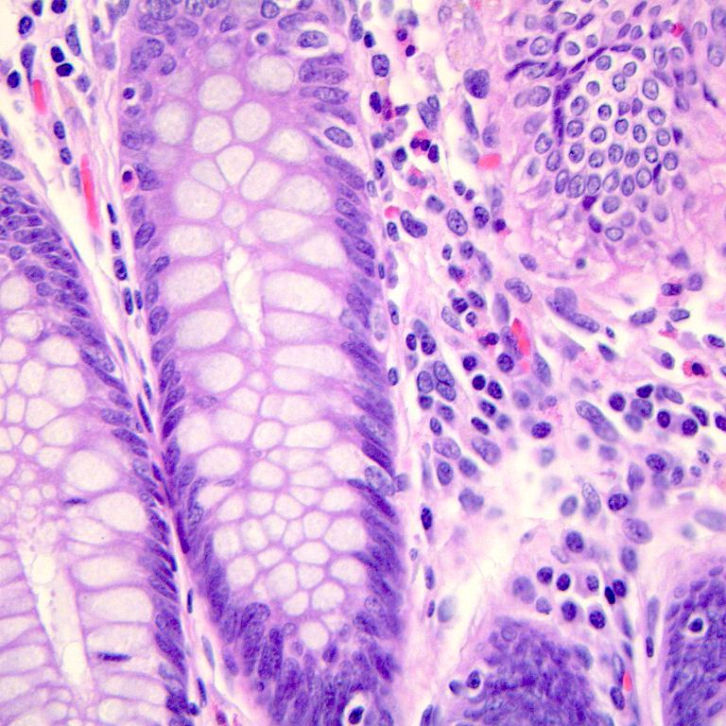
•Colon adenocarcinoma

Slide 21
•Colon benign tissue

Slide 22
Data Exploration Summary:
Dataset Composition:Histopathological images categorized by cancer type and stage.
Class Distribution: Balanced dataset with equal representation of each class.
Image Characteristics: High-resolution images with significant variations in color, texture, and morphology.
Data Preprocessing: Resizing, normalization, and data augmentation applied for consistency and model improvement.
Initial Observations: Prominent cellular structures and tissue patterns identified as potential features. Preliminary data visualization revealed class-specific variations.
Challenges: Variability in staining and image quality, requiring robust preprocessing. Classification of subtle tissue differences demands a highly precise model.

